Slide 1
Introduction Experiment Theory Conclusion
Experimental and theoretical study of pattern identification
in physical systems with O(2) symmetry
Rory Hartong-Redden
adviser
Professor Rouslan Krechetnikov
Department of Mechanical Engineering
June 15, 2010 – p. 1 / 24

Slide 2
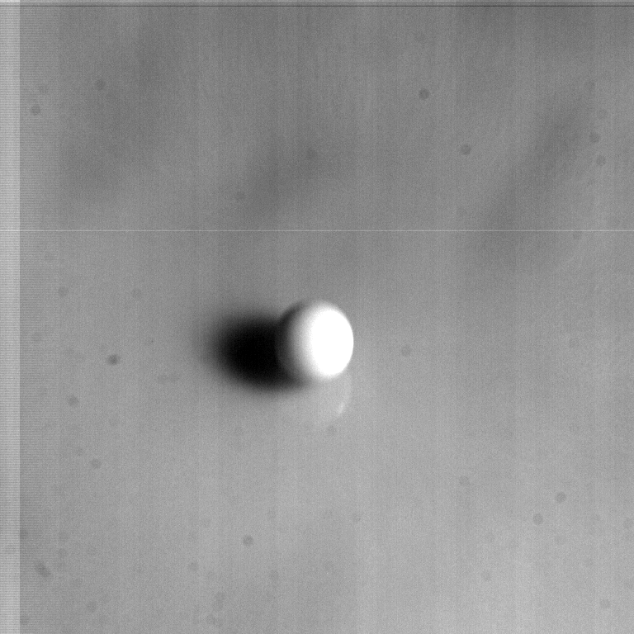
Introduction Experiment Theory Conclusion
Motivation: the drop splash problem
June 15, 2010 – p. 2 / 24

Slide 3
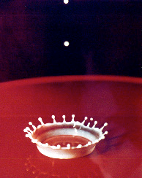
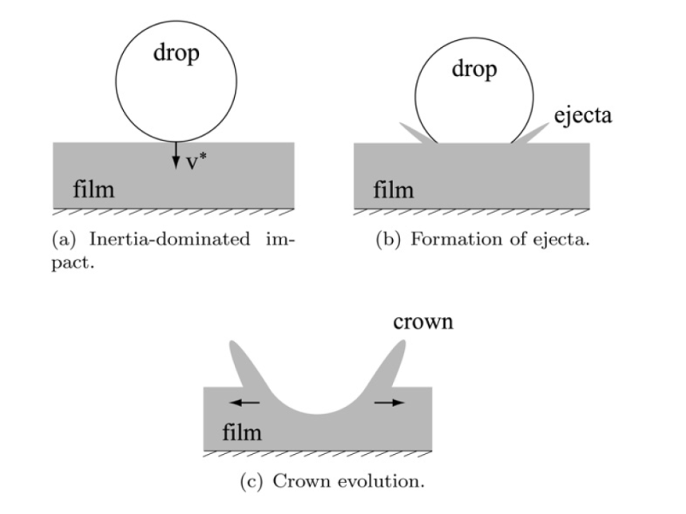
Introduction Experiment Theory Conclusion
Motivation: the drop splash problem
1. Physical setup: liquid with known properties
2. Geometry: droplet height, diameter, film thickness
Edgerton’s “milk coronet,” 1936
The three stages of crown formation. Taken from
R. Krechetnikov, G.M. Homsy. “Crown forming instability in the drop splash problem.” J. Colloid Interface Sci 331 (2009) 555-559.
June 15, 2010 – p. 3 / 24

Slide 4
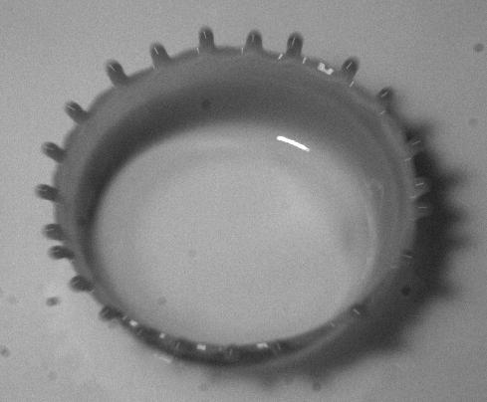
Introduction Experiment Theory Conclusion
Experimental objective
Quantitative description of a rim
1. Spikes lie on a circle
2. Each spike described by an angle
June 15, 2010 – p. 4 / 24

Slide 5
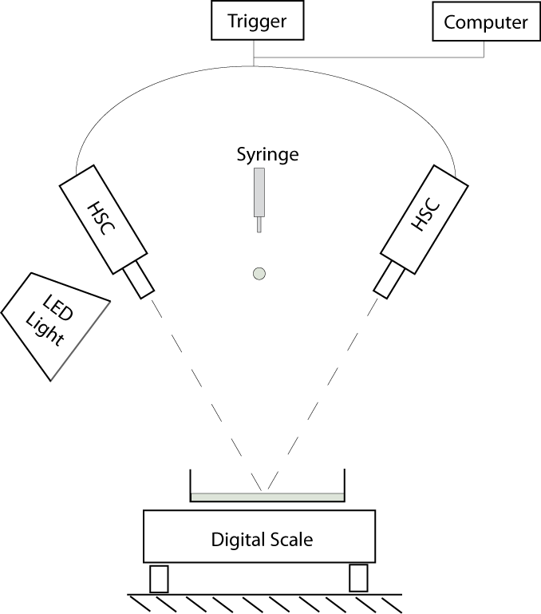
Introduction Experiment Theory Conclusion
Experimental Setup
Components
- two high speed cameras
- precision balance
- pump and syringe
- triggering device (function generator)
- high intensity light (LED bulb)
June 15, 2010 – p. 5 / 24
Notes:
LEDTRONICS
PAR38-12X2W-XPW-001S

Slide 6
Introduction Experiment Theory Conclusion
Stereo calibration and triangulation
1. Stereo triangulation – the determination of 3D points from a pair of
coordinates on an image
2. Requires that cameras be calibrated – implemented using the “Camera
Calibration Toolbox for Matlab” by J.Y. Bouguet
Stereo triangulation requires knowledge of the rotation R and translation T between the left and right cameras. Taken from J.Y. Bouguet, “Visual methods for three-dimensional modeling.” PhD thesis, Caltech, 1999.
Images used to calibrate each camera. Each checkerboard
June 15, 2010 – p. 6 / 24

Slide 7
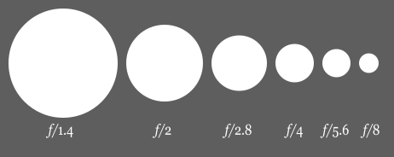
Introduction Experiment Theory Conclusion
Experimental discussion
Three inter-related experimental challenges
1. Focus and depth of field
a. f-number
b. depth of field
2. Sufficient lighting and contrast
a. position and quantity of lighting
b. opacity of liquid
3. Controlled environment
a. stable temperature
b. positioning equipment
Diagram illustrating increasing f-numbers, taken from wikipedia
June 15, 2010 – p. 7 / 24

Slide 8
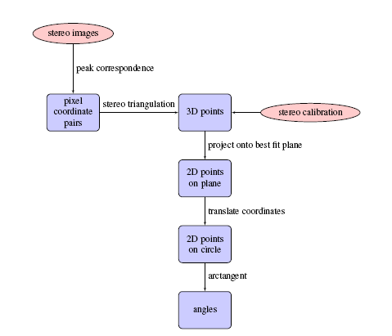
Introduction Experiment Theory Conclusion
Data analysis procedure
1. Capture images of drop splash
2. Identify corresponding crown peaks by hand
3. Use stereo triangulation to extract 3D points
4. Project onto plane
5. Project onto circle
6. Project onto circle, calculate angles using
atan2(y/x)
Corresponding spikes labeled by number in left and right images
June 15, 2010 – p. 8/ 24

Slide 9
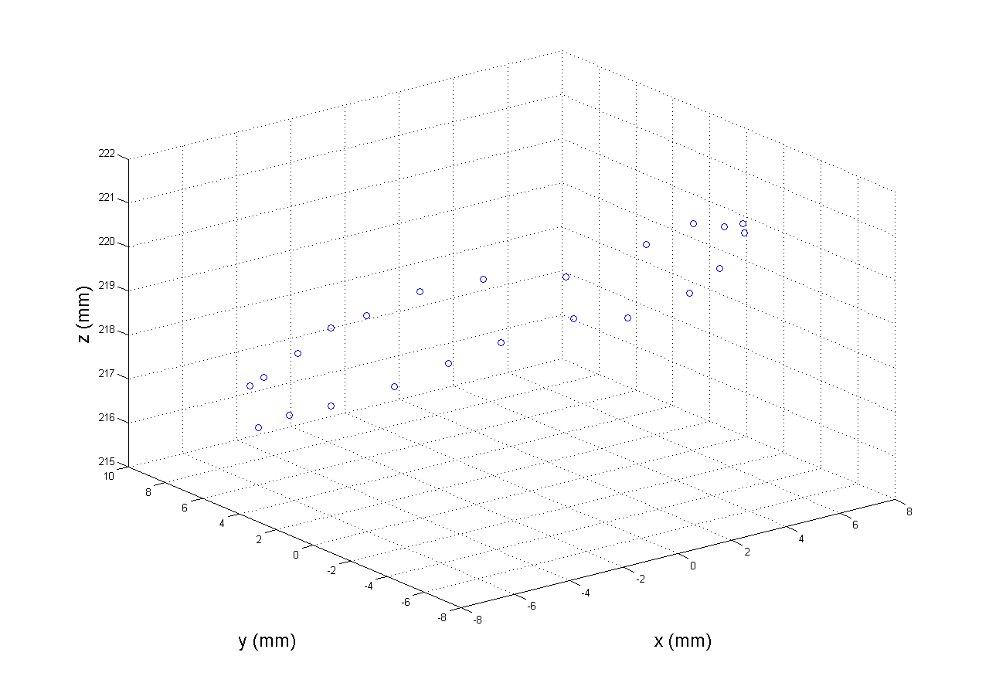
Introduction Experiment Theory Conclusion
Data analysis procedure
1. Capture images of drop splash
2. Identify corresponding crown peaks by hand
3. Use stereo triangulation to extract 3D points
4. Rotate into best fit plane
5. Project onto x-y plane
6. Project onto circle, calculate angles using
atan2(y/x)
Result of stereo triangulation, in the reference frame of the left camera
June 15, 2010 – p. 9/ 24

Slide 10
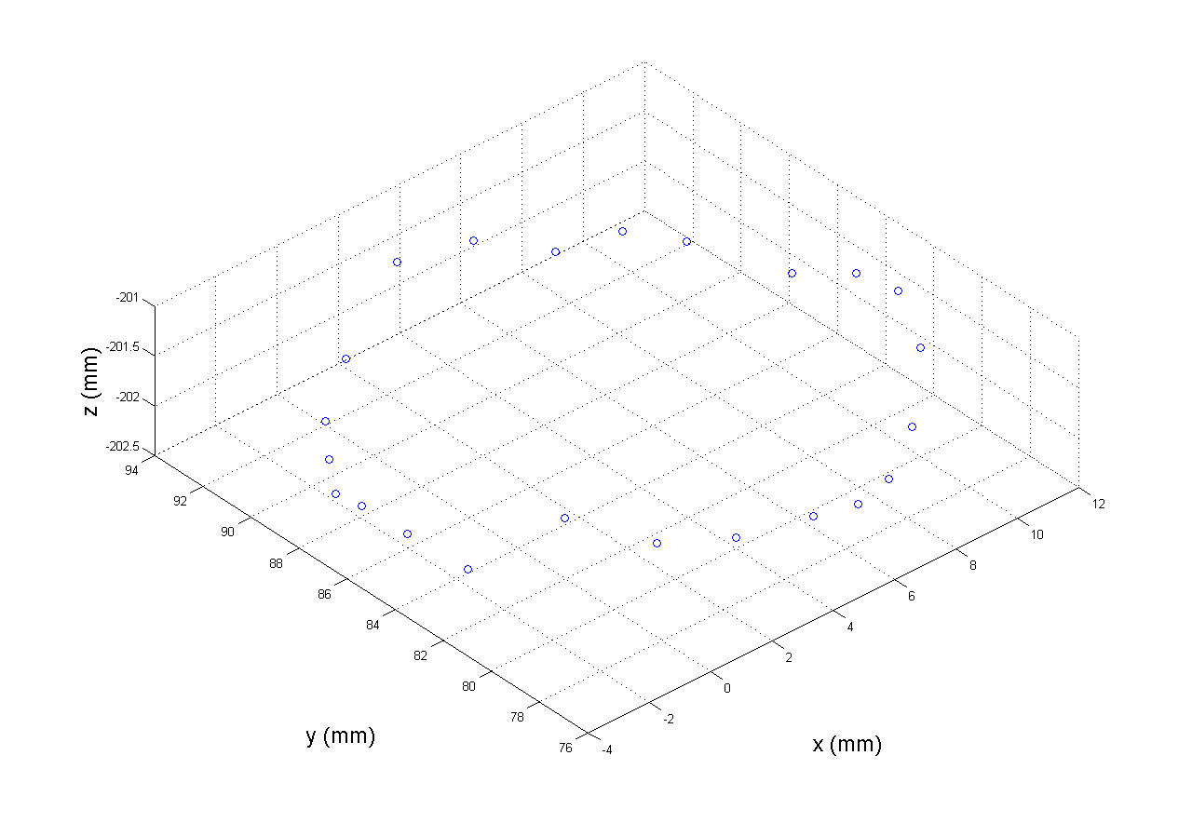
Introduction Experiment Theory Conclusion
Data analysis procedure
1. Capture images of drop splash
2. Identify corresponding crown peaks by hand
3. Use stereo triangulation to extract 3D points
4. Rotate into best fit plane
5. Project onto x-y plane
6. Project onto circle, calculate angles using
atan2(y/x)
Result of stereo triangulation, in the reference frame of the left camera
June 15, 2010 – p. 10/ 24

Slide 11
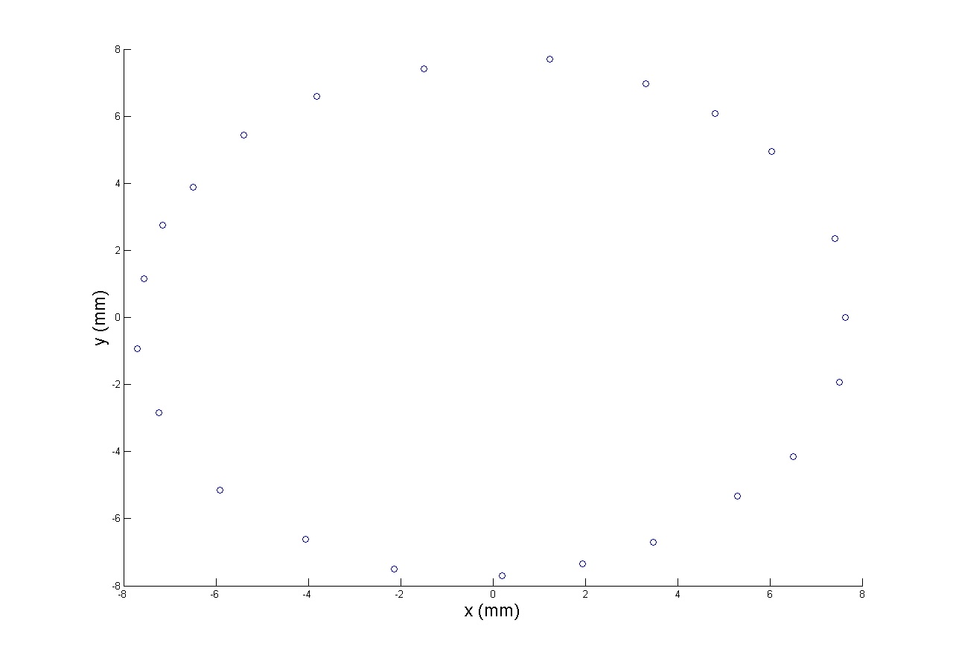
Introduction Experiment Theory Conclusion
Data analysis procedure
1. Capture images of drop splash
2. Identify corresponding crown peaks by hand
3. Use stereo triangulation to extract 3D points
4. Rotate into best fit plane
5. Project onto x-y plane
6. Project onto circle, calculate angles using
atan2(y/x)
2D points in x-y plane, origin coincident with center of best fit circle
June 15, 2010 – p. 11/ 24

Slide 12
Introduction Experiment Theory Conclusion
Data analysis procedure
1. Capture images of drop splash
2. Identify corresponding crown peaks by hand
3. Use stereo triangulation to extract 3D points
4. Project onto plane
5. Project onto circle
6. Project onto circle, calculate angles using
atan2(y/x)
The result of data analysis procedure: angles, displayed here as points on a circle
June 15, 2010 – p. 12/ 24

Slide 13
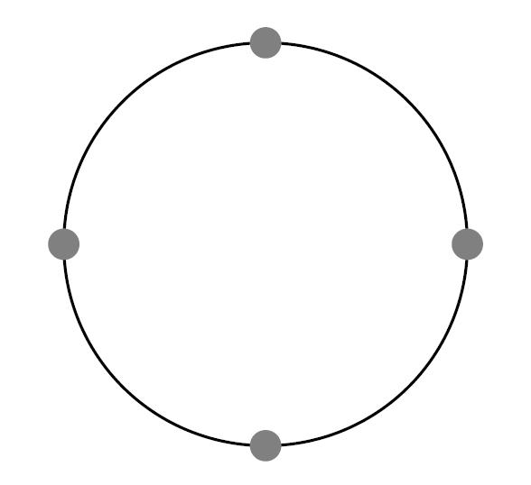
Introduction Experiment Theory Conclusion
Theory: patterns
Types of patterns
1. Single-wavenumber patterns
2. Regular patterns composed of single-wavenumber patterns (frustration)
3. Irregular patterns
Two key questions
1. Under what conditions is a regular pattern identifiable?
2. What is the “pattern decomposition”?
Ideal pattern
Experimentally determined pattern
June 15, 2010 – p. 13 / 24

Slide 14
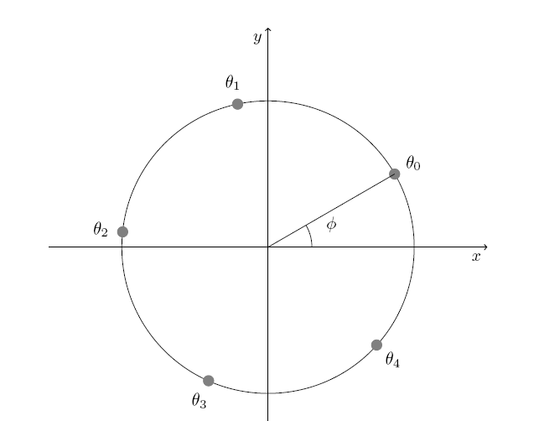
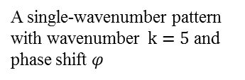
Introduction Experiment Theory Conclusion
Definition: single-wavenumber pattern
1. Informally: a set of uniformly spaced points
2. Ideal single-wavenumber pattern, formally:
A single-wavenumber pattern with wavenumber $k=5$ and phase shift $φ$
June 15, 2010 – p. 14 / 24

Slide 15
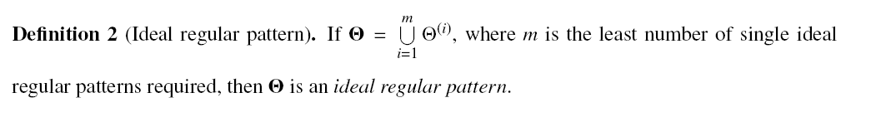
Introduction Experiment Theory Conclusion
Definition: ideal regular pattern
1. Informally: a superposition of multiple single-wavenumber patterns
2. Ideal regular pattern, formally:
An ideal regular pattern consisting of two single-wavenumber patterns: k=3 (red) and k=4 (blue)
June 15, 2010 – p. 15 / 24

Slide 16
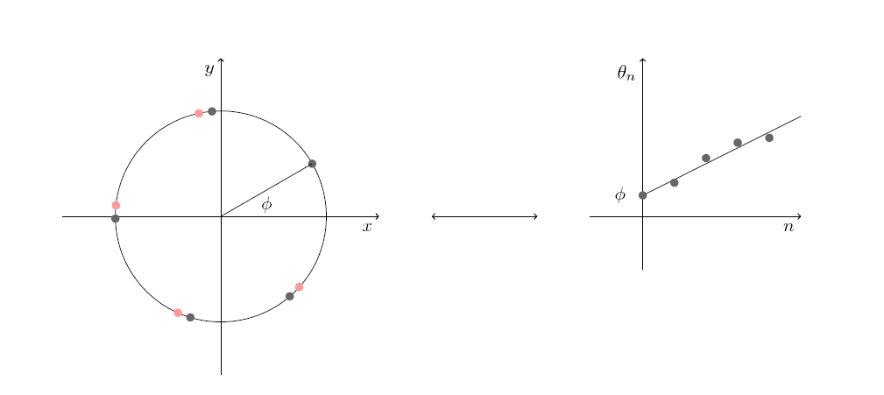
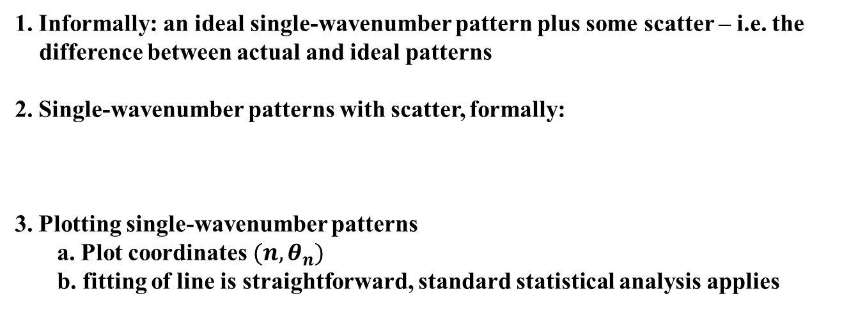
Introduction Experiment Theory Conclusion
Definition: single-wavenumber pattern with scatter
1. Informally: an ideal single-wavenumber pattern plus some scatter – i.e. the
difference between actual and ideal patterns
2. Single-wavenumber patterns with scatter, formally:
3. Plotting single-wavenumber patterns
a. Plot coordinates $(n, θ_{n})$
b. fitting of line is straightforward, standard statistical analysis applies
A single-wavenumber pattern with scatter plotted on a circle, and its corresponding representation on a graph
June 15, 2010 – p. 16 / 24

Slide 17
Introduction Experiment Theory Conclusion
Pattern identification
Theoretical stumbling blocks
1. Scatter (due to goodness of fit and experimental uncertainty)
2. Overlapping patterns (due to resolution, and merging of spikes due to surface tension)
3. Incomplete patterns (patterns which are missing one or more points)
Motivates three questions
1. How do we identify a given pattern as regular?
2. Under what conditions can we identify regular patterns?
3. How do we quantify how regular it is?
June 15, 2010 – p. 17 / 24

Slide 18
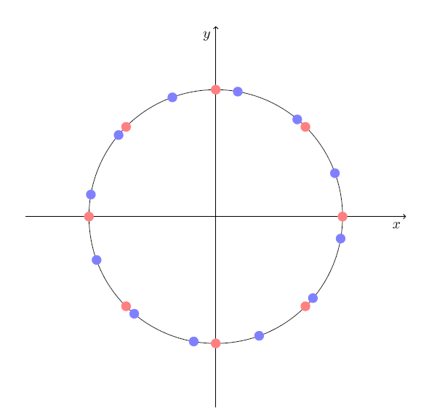
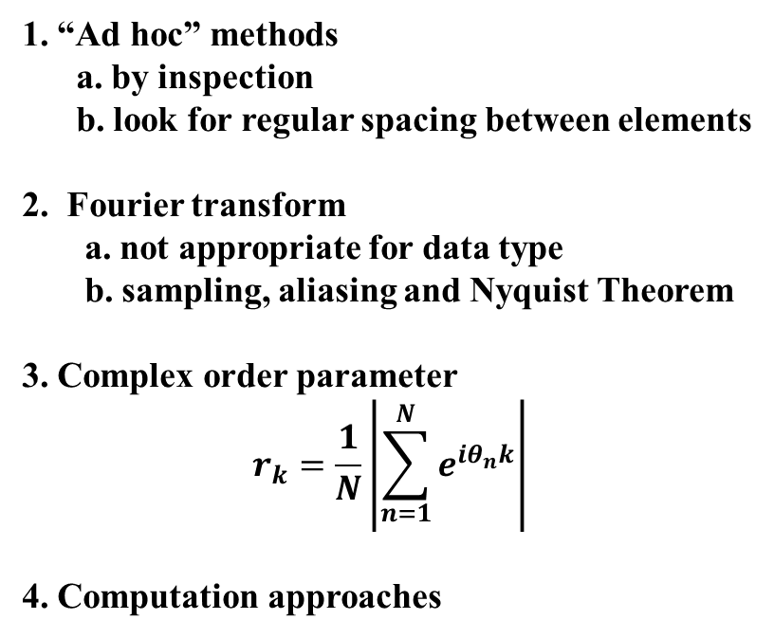
Introduction Experiment Theory Conclusion
Pattern identification: other approaches
1. “Ad hoc” methods
a. by inspection
b. look for regular spacing between elements
2. Fourier transform
a. not appropriate for data type
b. sampling, aliasing and Nyquist Theorem
3. Complex order parameter
$$r_{k}=\frac{1}{N}\left|\sum_{n=1}^{N}{e^{iθ_{n}k}}\right|$$
4. Computation approaches
An ideal regular pattern consisting of two single-wavenumber patterns: k=8 (red) and k=12 (blue)
June 15, 2010 – p. 18 / 24

Slide 19
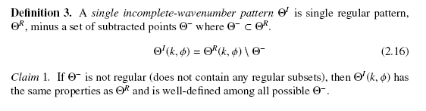
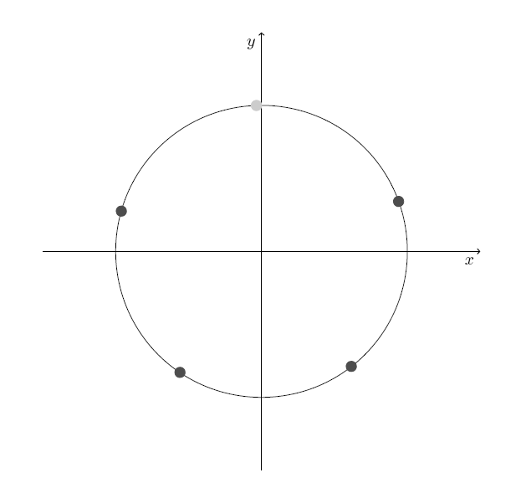
Introduction Experiment Theory Conclusion
Definition: incomplete patterns
1. Informally: patterns which are regular, but missing one or more points
2. Incomplete patterns, formally:
An incomplete pattern consisting of a single-wavenumber pattern with one point missing
June 15, 2010 – p. 19 / 24

Slide 20
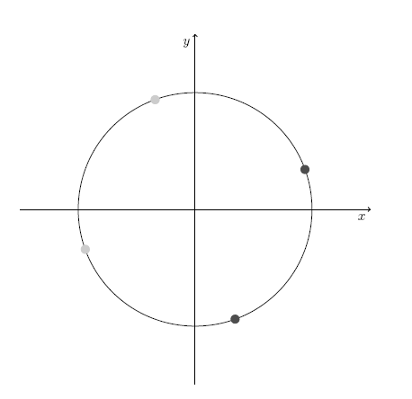
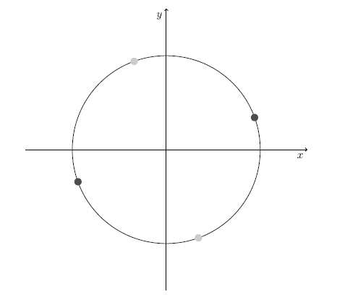
Introduction Experiment Theory Conclusion
Incomplete patterns
1. Want an incomplete pattern definition which retains phase
and wavenumber information
2. Consider as an example a complete pattern with k=4
a. remove a single point
b. remove two points – leads to trouble
June 15, 2010 – p. 20 / 24

Slide 21
Introduction Experiment Theory Conclusion
Summary of theoretical results
1. A new theoretical framework for patterns
a. Clear definitions of patterns: single-wavenumber,
regular, irregular
b. Classification of theoretical problems: ideal regular
patterns, patterns with overlaps, incomplete patterns
2. Algorithms – implemented in Matlab
a. can identify non-overlapping ideal regular patterns
with and without scatter
Edgerton’s “milk coronet,” 1936
June 15, 2010 – p. 21 / 24

Slide 22
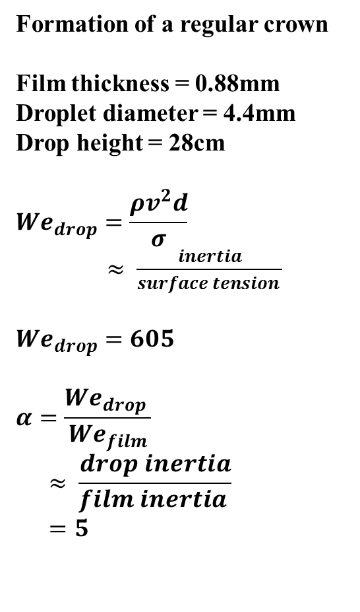
Introduction Experiment Theory Conclusion
Drop splash video
Formation of a regular crown
Film thickness = 0.88mm
Droplet diameter = 4.4mm
Drop height = 28cm
$${We}_{drop}=\frac{ρv^{2}d}{σ}$$
$≈ \frac{inertia}{surface tension }$
$${We}_{drop}=605$$
$$α=\frac{{We}_{drop} }{{We}_{film}}$$
$$≈ \frac{drop inertia}{film inertia }$$
$$=5$$
June 10, 2010 – p. 22 / 24

Slide 23
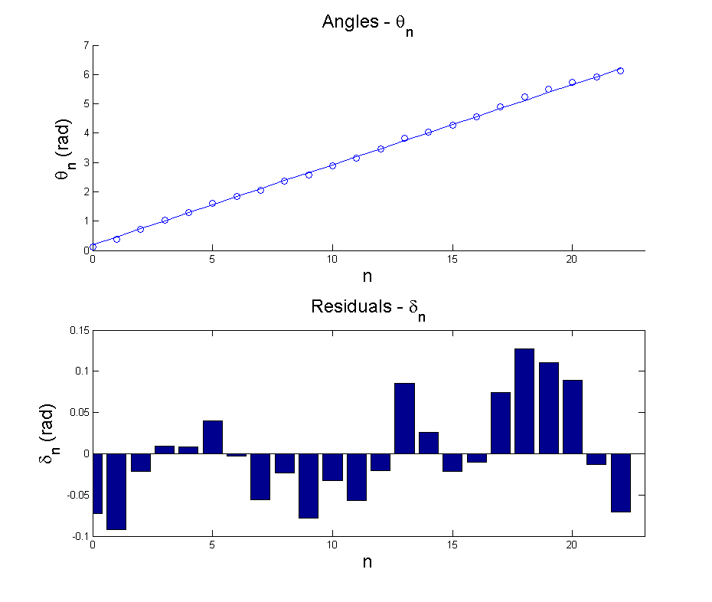
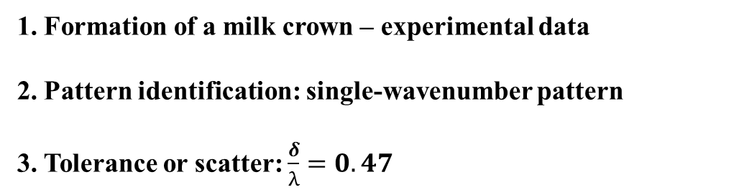
Introduction Experiment Theory Conclusion
Application to experimental data: regular crown
1. Formation of a milk crown – experimental data
2. Pattern identification: single-wavenumber pattern
3. Tolerance or scatter: $\frac{δ}{λ}=0.47$
Experimentally determined pattern – frame 9 from previous video
The result of fitting the experimental pattern to the single-wavenumber pattern with scatter model
June 10, 2010 – p. 23 / 24

Slide 24
Introduction Experiment Theory Conclusion
Conclusions and Future Work
Key results
1. New experimental setup with quantitative
data on rim structure
2. New theoretical framework for pattern identification
Outstanding issues
1. Further exploration of parameter space
a. single-wavenumber rims with less scatter
b. identify a case of “frustration”
2. Theoretical treatment of incomplete patterns with scatter
Image taken from Parker Hannifin brochure
June 15, 2010 – p. 24/ 24

Slide 25
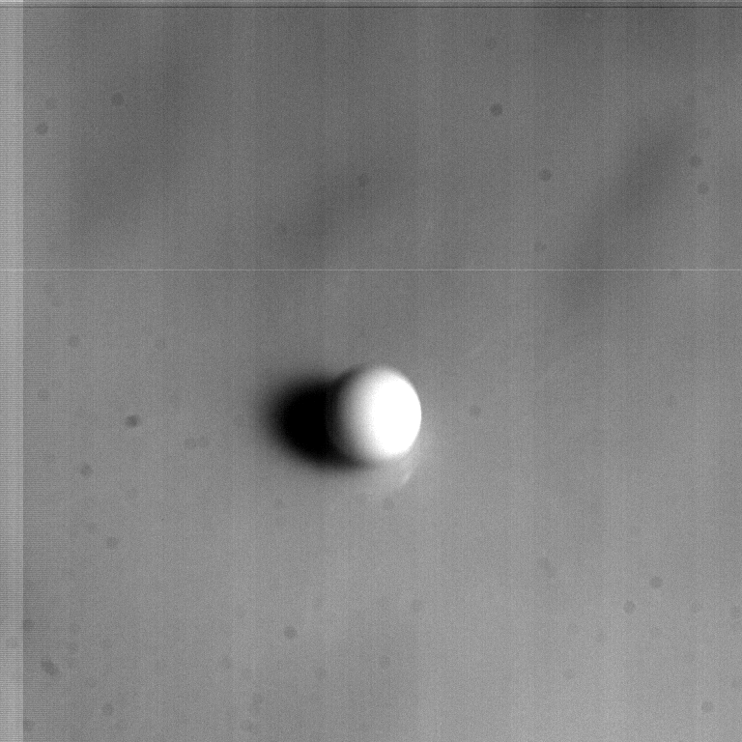
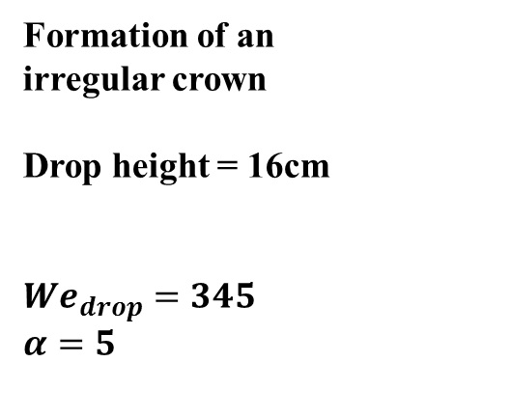
Introduction Theory Experiment Conclusion
Appendix: video of an irregular crown
Formation of an
irregular crown
Drop height = 16cm
$${We}_{drop}=345$$
$$α=5$$
June 10, 2010 – p. 25 / 24

Slide 26
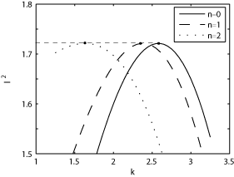
Introduction Theory Experiment Conclusion
Appendix: motivation – frustrated rims
Why are there a certain number of spikes?
1. Along the rim instabilities: Richtmyer-Meshkov instability
2. Superposition of regular patterns = “frustration”
Image taken from G. Homsy, R. Krechetnikov. “Crown-forming instability in the drop splash problem.”
A frustration picture?
Equal growth rates indicates the possible superposition of three wavenumbers
June 10, 2010 – p. 26 / 24

Slide 27
Introduction Experiment Theory Conclusion
Appendix: single-wavenumber pattern factoring
Example:
A single-wavenumber pattern with k=6 is also:
1. two k=3 patterns
2. three k=2 patterns
June 15, 2010 – p. 27 / 24

Slide 28
Introduction Experiment Theory Conclusion
Appendix: pattern identification algorithm
For ideal regular patterns with possible overlaps
Key idea: identify all patterns (steps 1-6) and then remove subpatterns (step 7)
Finite differences:
June 15, 2010 – p. 28 / 24

Slide 29
Introduction Experiment Theory Conclusion
Data analysis example
June 15, 2010 – p. 29/ 21

Slide 30


Introduction Experiment Theory Conclusion
Presentation Outline
1. Introduction
2. Pattern identification theory
3. Experimental study
Image taken from JFM Online
Image taken from efluids, credit: Abhishek Joshi
June 15, 2010 – p. 2 / 21

Slide 31
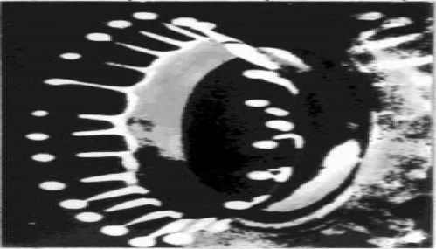
Introduction Theory Experiment Conclusion
Introduction
1. Systems with O(2) symmetry
a. domain of a circle
b. Time domain
c. Spatial domain
2. A different type of data
a. 1-Dimensional
b. Patterns which deal with
order of data points
S. P. Betyaev, Physics Uspekhi
June 10, 2010 – p. 3 / 21

